Slide 1

Sterling E-Commerce Performance Report
This report analyzes Sterling's e-commerce performance data from October 2021 to December 2022, providing insights and recommendations for optimizing business operations, improving customer retention, and increasing sales.
by IBOR STELLA
IS

Slide 2
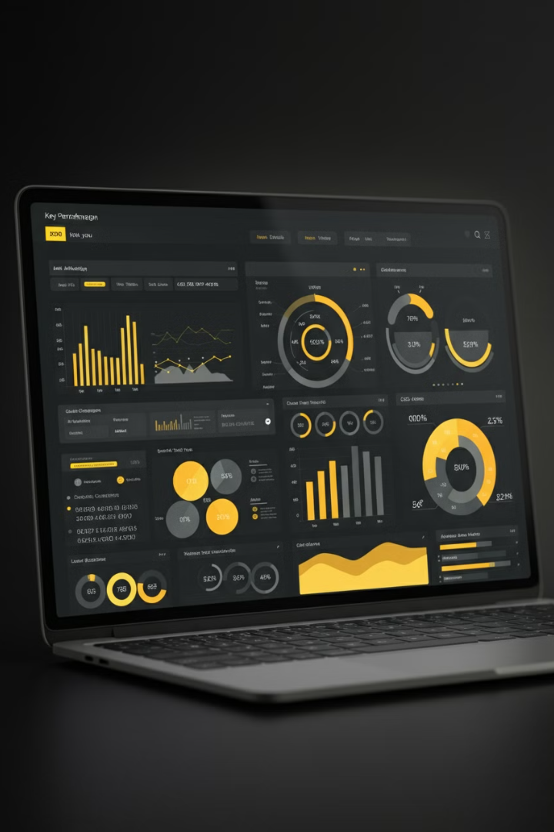
Executive Summary
1
Data Analysis
The report leverages Excel's Power Pivot and PivotTables to analyze Sterling's e-commerce data.
2
Key Performance Indicators (KPIs)
Key performance indicators (KPIs) were developed and visualized to provide insights into Sterling's performance.
3
Actionable Recommendations
The report summarizes key findings and provides actionable recommendations for optimizing business operations and driving growth.

Slide 3
Data Overview
The dataset comprises 283,083 rows and 19 columns, representing a significant volume of e-commerce transactions. To ensure data quality and accuracy, a comprehensive data cleaning process was implemented.
Data Cleaning Process
Data Consistency & Accuracy
Removed duplicate records to eliminate redundancy and potential bias in analysis.
The data cleaning process aimed to ensure data consistency and accuracy, eliminating potential errors and inconsistencies that could impact the analysis.
Handled missing values using the COUNTBLANK function and filtering techniques to identify and address incomplete data points.
Applied TRIM and CLEAN functions to standardize text fields, ensuring data consistency and uniformity.
Verified and adjusted data types to ensure accurate calculations and analysis.

Slide 4
Data Cleaning & Transformation Details (Part 1)
Count Blank
Duplicates
Data Trimming and Cleaning
Data Types Adjustment
The COUNTBLANK function was used to identify and fill or remove blank cells, ensuring data consistency and completeness.
Duplicate rows were removed to avoid skewed analysis and ensure that each transaction was represented only once.
TRIM and CLEAN functions were applied to standardize text fields, removing unnecessary spaces and characters for data uniformity.
Data types were verified and adjusted to ensure that fields like dates and sales values were correctly formatted for accurate calculations.

Slide 5
Data Cleaning & Transformation Details (Part 2)
Customer Longevity
Order Count
Customer Longevity was calculated by finding the difference between the "Customer Since" date and the "Date of Order". This metric provides insights into the duration of customer relationships with Sterling.
The Order Count column tracks the number of transactions made by each customer. This metric helps understand customer engagement and purchasing frequency.

Slide 6
Data Modeling & Transformation
Fact Table (Fcat_Table)
Dimension Tables
The Fact Table consolidates transactional data, providing a central repository for all sales and order information. It includes details such as order date, customer ID, product category, quantity sold, and total revenue.
Dimension tables provide additional context and attributes for the data in the Fact Table. They include information about product categories, customer demographics, geographic locations, payment methods, and gender segmentation.

Slide 7
Relationships & Merging
Table Relationships
Normalized Data Structure
The Fact Table (Fcat_Table) and dimension tables were merged using keys, such as CustomerID and LocationID. This ensures that data from different tables is correctly linked and analyzed together.
The merging process resulted in a normalized data structure, which is essential for efficient analysis. This structure eliminates data redundancy and ensures that each piece of information is stored only once.

Slide 8
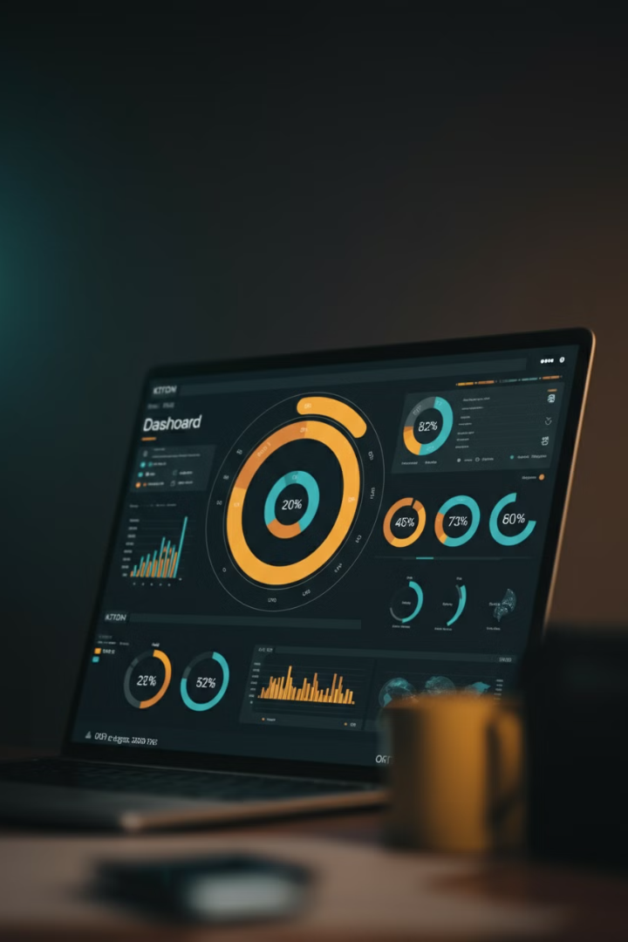
KPIs Developed
£231M
Total Revenue
Sum of all transaction values.
852K
Total Quantity Sold
Total units sold across all transactions.
816
Average Order Value (AOV)
Total revenue divided by number of orders.
14Years
Customer Lifetime Value (CLV)
Average revenue generated per customer over their engagement period.

Slide 9
Dashboard Visualizations (Part 1)
Top-Level KPIs
Customer Insights
The dashboard displays total revenue, quantity sold, average order value (AOV), and customer lifetime value (CLV). Interactive slicers allow users to filter data by year (2021, 2022) and region (Midwest, Northeast, South, West).
The dashboard provides insights into customer demographics and behavior. A pie chart shows the gender split of customers (male vs. female). A bar chart categorizes customers based on their longevity with Sterling, highlighting the revenue contribution of each customer segment.

Slide 10
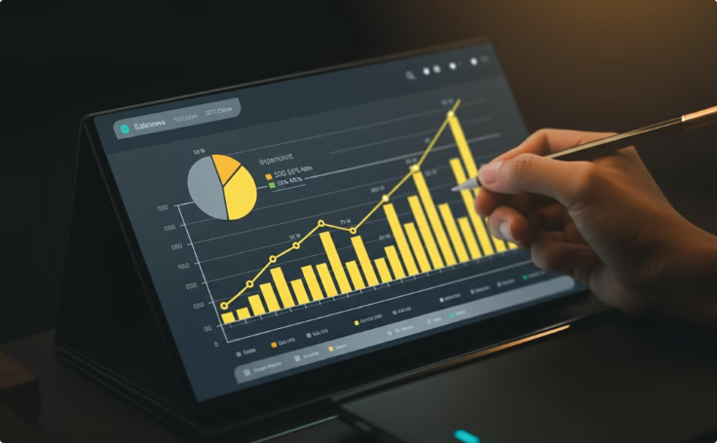
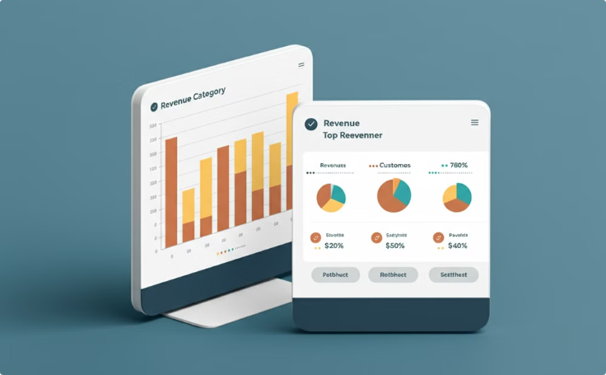
Dashboard Visualizations (Part 2)
Sales Performance
Product & Payment Analysis
The dashboard includes a line chart displaying sales growth over time, highlighting percentage increases per month. A pie chart shows the distribution of sales by geographic region.
The dashboard provides insights into product performance and payment method usage. A bar chart highlights revenue contribution by product category, while another bar chart lists top customers by revenue. A final bar chart shows the usage and revenue generated by different payment methods.

Slide 11
Key Insights & Recommendations (Part 1)
Top Performing Product Categories
Regional Focus
The Mobiles & Tablets category significantly contributes to overall revenue. Expanding and promoting this category is recommended.
Sales are concentrated in certain regions (Midwest, Northeast). Targeted marketing campaigns and inventory optimization are recommended.

Slide 12
Key Insights & Recommendations (Part 2)
Customer Segmentation & Retention
Payment Method Optimization
The customer base is nearly equally split between male and female customers, suggesting the need for gender-specific marketing strategies. Customers with more than 10 years of engagement contribute a significant portion of revenue, highlighting the importance of loyalty programs or VIP customer initiatives.
Cash on Delivery (COD) is the most popular payment method. Encouraging electronic payments by offering discounts or cashback incentives is recommended to streamline transactions and potentially reduce costs.

Slide 13
Key Insights & Recommendations (Part 3)
Payment Method Optimization
Sales Seasonality
Cash on Delivery (COD) is the most popular payment method. Encouraging electronic payments by offering discounts or cashback incentives is recommended to streamline transactions and potentially reduce costs.
Significant sales spikes in December. Recommend optimizing inventory levels and increasing marketing efforts during Q4.

Slide 14
Conclusion
Key Takeaways
Actionable Steps
The analysis and visualization efforts provided valuable insights into Sterling's e-commerce performance. These insights highlight key areas for improvement, such as product category optimization, regional marketing strategies, and customer retention initiatives.
Leverage the identified KPIs and data-driven recommendations to optimize product offerings, refine marketing strategies, improve customer retention, and drive sustainable growth. By implementing these strategies, Sterling can enhance its e-commerce operations and achieve its business objectives.

